Slide 1

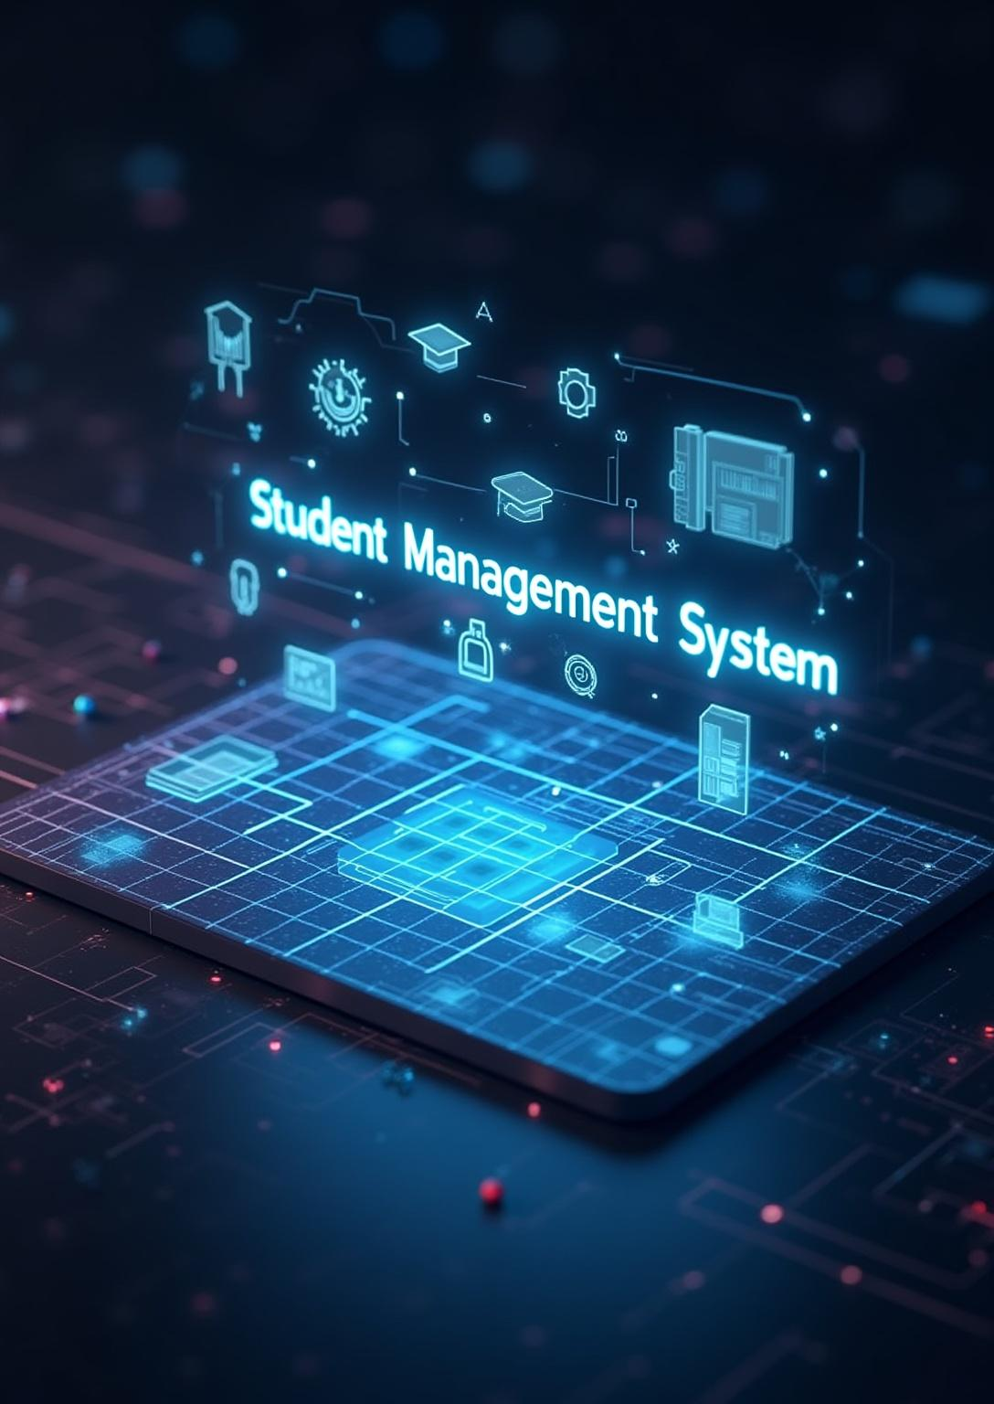
Educational Institute Management System
Presented By:
    Abdur Rahman
    Binyameen
    M. Mateen Arshad
    Taimour Mushtaq
Presented To:
Mr. Muhammad Aqib Rauf
Federal Urdu University of Arts, Science and Technology Islamabad

Slide 2
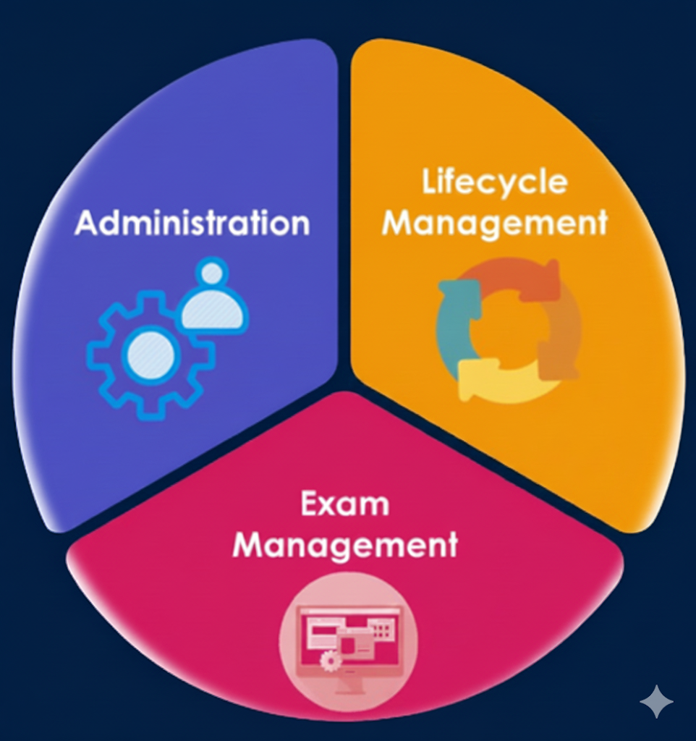
Introduction
The Educational Institute Management System is a desktop-based application.
It manages essential academic operations more efficiently.
This system simplifies the handling of educational system with user-friendly interface.
Fig
Fig 1: Project Cycle

Slide 3
Intro (Cont…)
It is especially suitable for small to medium-sized schools.
Built using .NET and SQL Server, the system aims to reduce manual paperwork.
This project is ideal for academic learning, allowing students to practice database design, form development, and backend integration while solving real-world problems in education management.

Slide 4
Literature Review
Modules | SMS JUIT | SMS KPIT | CMS Mashi
Secure Login | ✓ (Basic Login) | ✗ | ✓(Not Secure)
Admin Panel | X | ✓ | ✗
Attendance System | ✗ | ✓ | ✓
Password Retrieval | ✗ | ✗ | ✗
Scalable & Secure Database | ✗ | ✗ | ✗

Slide 5
Problem Statement
Many existing systems are either over-featured and expensive or too technical to deploy and maintain for smaller institutes.
Typical problems:
    Lack of Security.
    No Admin Panel.
    Deficiency of Proper Attendance System.
    Dependency on internet/servers.
    Lack of essential checks and Password Retrieval.
    Limited scalability when built on lightweight DBs.
    Customization is limited.

Slide 6

Solution
This project introduces a simple, affordable, and fully offline Desktop-Based Educational Institute Management System designed specifically for smaller institutes.
Our system offers:
  Increase security using role based login systems.
  Full fledge admin control panel with all required resources and full controls.
  Automated class scheduling and attendance system with duplicate-protection.
  Offline operation, no server or internet required.
  Password retrieval system.
  Accurate and reliable SQL Server database for secure record management and increase scalability.
  Lightweight application with customization options (chatbots dev etc).

Slide 7
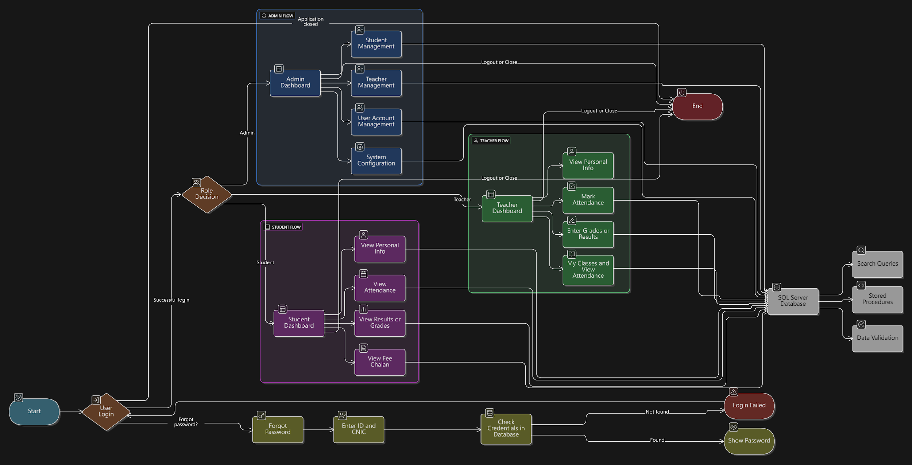
Methodology

Slide 8
Methodology (Cont…)
System Planning & Design
  Gather requirements for students, teachers, classes, and attendance
  Identify system modules (Student, Teacher, Timetable, Attendance, Login)
  Design database structure (tables, primary/foreign keys, relationships)
  Create basic UI layout/wireframes for form
Development
  Build SQL Server database with relationships and constraints
  Develop Windows Forms using C# and .NET
  Implement CRUD operations for all modules using ADO.NET
  Add class scheduling and attendance logic with duplicate-prevention
  Implement authentication (Admin/Teacher/Student roles)

Slide 9
Methodology (Cont…)
Testing & Deployment
  Test data insertion, search, timetable creation, and attendance marking
  Validate login access for all user roles
  Fix UI and database integration issues
  Prepare final build (.exe), documentation, and project presentation
Tech Stack
  Educational Institute
  .NET (Windows Forms)
  SQL Server
  C# programming language
  Visual Studio 2022
  ADO.NET for database access
  Eraser.IO
  Draw.IO
  MS Office
  Guna UI2

Slide 10

Results
Previous Work | Current Work
Used MySQL / MS Access with limited scalability | Uses SQL Server with strong relationships and future scalability
Simple outdated UI | Clean, user-friendly, modern Windows Forms UI
No password recovery features | Secure Password Retrieval system
No secure login or single-user access | Role-based Login (Admin, Teacher, Student)
No attendance system or prone to duplicate marking | Attendance system with duplicate-entry prevention

Slide 11

Conclusion
The Educational Institute Management System provides a practical and efficient solution for managing essential school operations.
Designed to be simple yet fully functional, it is ideal for academic learning as well as real-world use in small to medium-sized educational institutes.
Its modular structure and beginner-friendly interface make it easy for users and developers to understand, use, and extend.
The project offers students an excellent opportunity to practice programming, explore system design, and build a complete working application with real educational value.
It supports hands-on learning by combining concepts of database management, UI development, and backend integration into one meaningful project.

Slide 12

References
Student Management System developed by Students of "Jaypee University of Information Technology“.
Student Management System by "KRISHNA’S PRAGATI INSTITUTE OF TECHNOLOGY"
Student Management System Project Report |System | Design .
MashiAma/Student-Management-System: Implementation of Student Management System

Slide 13

Thank You For Your Cooperation

Slide 14


Any Questions?

